Slide 1
Nurse Leadership improving the culture of safety through the implementation of Unit Based Nurse Safety Huddle
2016 Safety Forum
April 11, 2016
Laurie Bausk, MM, BSN, RN, NE-BC
Stephanie Racca, BSN. RN

Slide 2
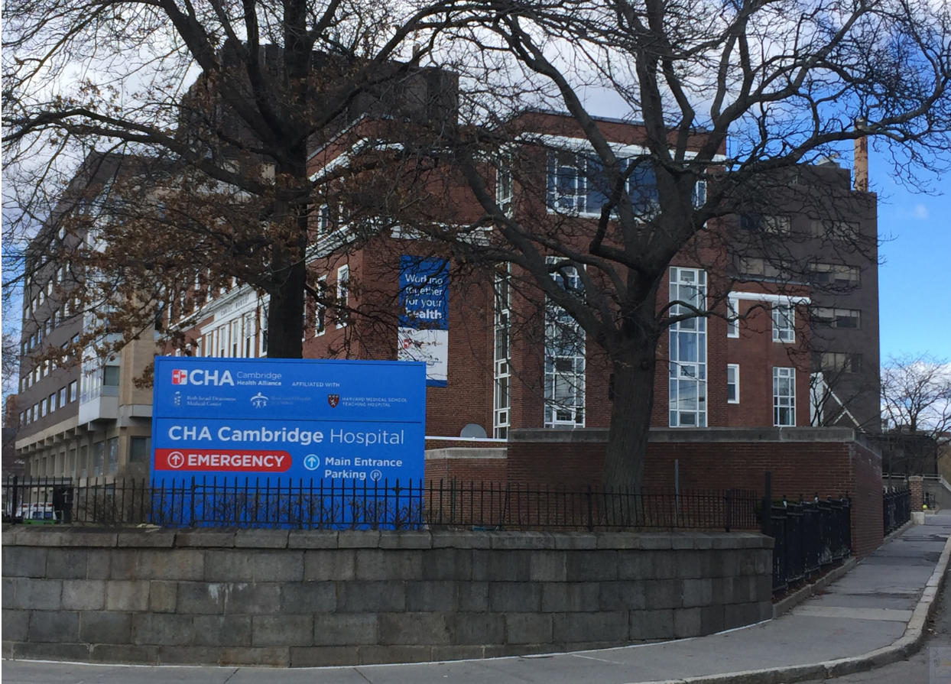
Notes:
Description of Cambridge Health Alliance:
3 hospitals – Cambridge, Somerville, and Whidden (Everett) – each with 24-hour emergency services
• 15 primary care practices
293 licensed beds
It also provides a vital safety net for underserved populations facing barriers to care.
Our special expertise in caring for vulnerable populations
Academic Community Health System for Harvard Medical School and the Tufts University School of Medicine
Cambridge Hospital has two 32 bed Med Surg Tele Units
4W is predominately medical and 6N has a surgical component
4W 2 Medical Teaching teams
6N 1 Hospitalist teaching team and multiple specialty teams
4W has had nursing leadership challenges 5 Manager in 14 years and inconsistent processes
6N has had consistent nursing leadership for the past 14 years and consistent processes in place.

Slide 3
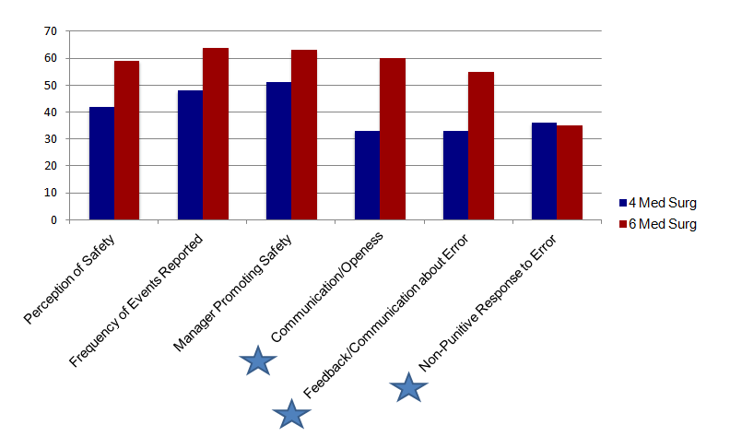
Timeline
Culture of Safety Survey November 2014
Result received June 2015
Consulted Risk Management Department to assist with interpretation of results
Literature review
Notes:
6N Highest response rate within CHA 7%
Describe confusion when we reviewed results at first glance
Internalizing the results
We determined a need to find help to interpret
Received clarity on the individual question and response meaning
Themes: Communication/Openness and feeling that mistakes are held against them
Now that we understand…How to we present to staff
Literature search came across safety Huddle on IHI website

Slide 4

The Journey
Staff Engagement
Rapid Cycle Change
6N Safety Huddle Pilot July 29, 2015 with pre/post safety huddle survey
4W Incorporated Safety Huddle components into daily clinical huddle August 18, 2015
Final product Safety Huddle standardized across both Med Surg units October 27, 2015
Notes:
Posted the results for all staff
Unit based staff meetings to discuss and brainstorm about what we can do as a unit and as a leader
We decided on 6N to implement a Safety Huddle pilot and utilizing an existing clinical huddle on 4W to increase safety awareness, identify and problem solve issues.
Huddles on both units occurring but had a different structure with similar end points.
Once the pilot ended a Safety Huddle survey was done on 6N looking for staff input about expanding the huddle to both shifts, looking for a time preference reducing from twice on days to once.

Slide 5
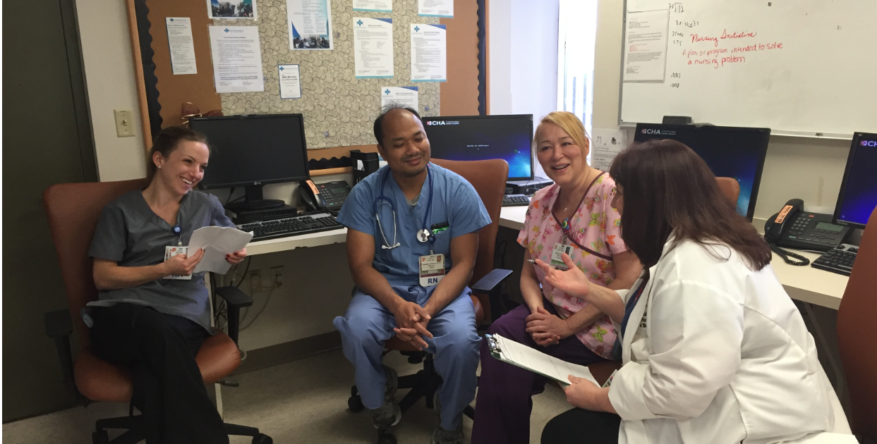
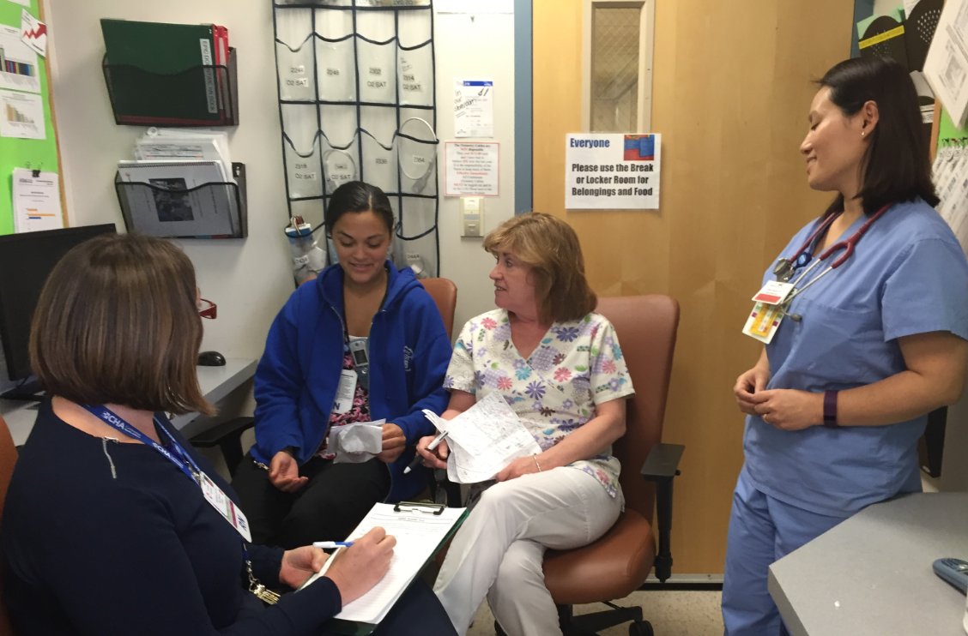
This is a good forum for issues that present during the shift
The huddle brings us together
Word on the “street”
I really like that we are heard when we voice our concerns
It’s a de-stressor
It’s a chance to brainstorm about problems and find solutions

Slide 6
Comparison of Rate of Safety Event Reporting
November 2014- February 2015 and
November 2015-February 2016

Slide 7


Lessons Learned
Power of nursing leadership presence
Importance of staff engagement
Greater success through collaboration
Please feel free to contact us at:
  Laurie Bausk Nurse Manager Med Surg 6 lbausk@challiance.org
  Stephanie Racca Nurse Manager Med Surg 4 sracca@challiance.org
  Mary Samost Associate Chief Nurse msamost@challiance.org
Notes:
Power of Nurse Manager presence
Partnering with staff
Good staff feel supported, feel heard down side it can turn into a daily staff meeting
Achieving greater success using rapid change Partnering with staff
What seems like a good idea as a communication tool can turn into a barrier

